Slide 1
The Influence of Caption Features on Clickthrough Patterns in Web Search
Clarke, Agichtein, Dumais and White
Venue: SIGIR’07
Predicting the Readability of Short Web Summaries
Tapas Kanungo and David Orr
Venue: WSDM’09

Slide 2
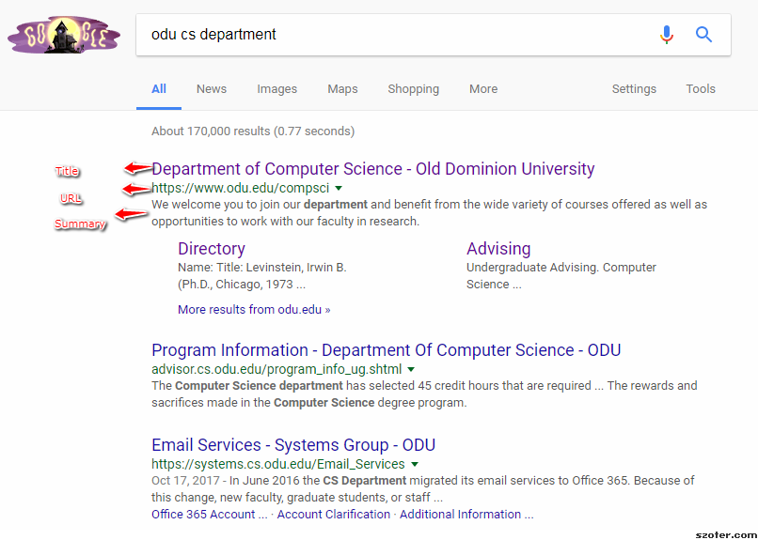
Google Search Results

Slide 3
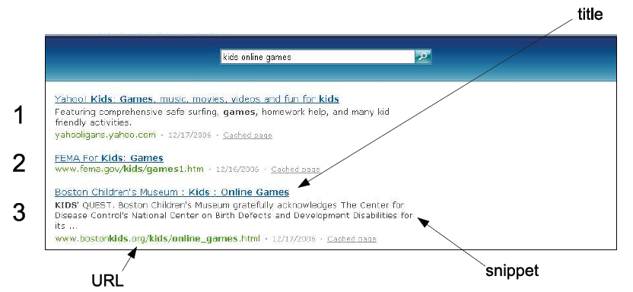
Search Results for Windows Live In 2007

Slide 4
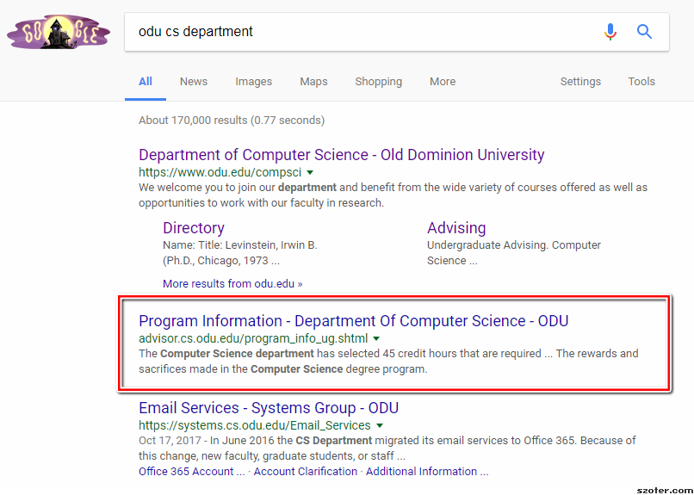
Clickthrough Inversion

Slide 5
Possible Reasons for Clickthrough Pattern
Ranking more relevant results below less relevant results
Although the relative ranking is appropriate, a caption fails to reflect the content of the underlying page with respect to the query

Slide 6
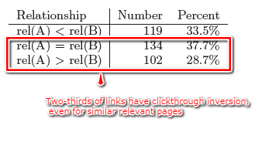
Relevance Relationship for Clickthrough Inversion
Total: 355

Slide 7
Major Guidelines which influence User Search Behavior
Whenever possible all of the query terms should appear in the caption, reflecting their relationship with the associated page.
When query terms are present in the title, they need to be repeated in the snippet.
URLs should be selected and displayed in a manner that emphasizes their relationship to the query.

Slide 8
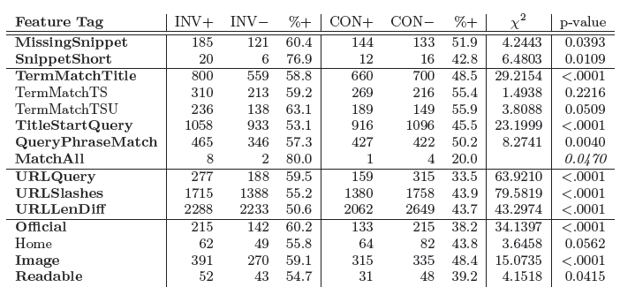
Result of Caption Features

Slide 9
Conclusion
Factors which have negative impact clickthroughs:
Missing snippets
Short snippets
Missing query terms
Complex URLs

Slide 10
Relationship between Papers
Seminal paper | Citing Paper
Model of readability was heuristic and not tested against human readability judgments | Relevant influence of features was measured by a machine learning algorithm and also validated against human readability judgments
Discuss coherence of results with guidelines for forming web summaries | Improve the guidelines to make the features and model better reflect how human judges score abstracts.

Slide 11
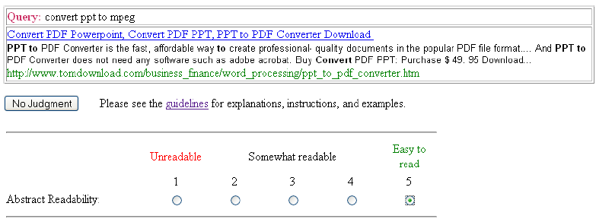
Human Approach of Computing Readability of Search Results
Tool provided to the editors to rate the abstracts

Slide 12
Machine Learning Model
Machine learning approach with 13 features to compare results with human readable approach
Model trained on 5382 judgments of readability done by seven editorial judges over about a year, on abstracts collected from Yahoo and Google search results.

Slide 13
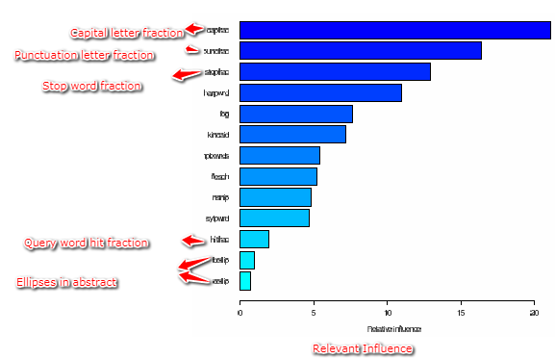
Relevant Influence of Features

Slide 14
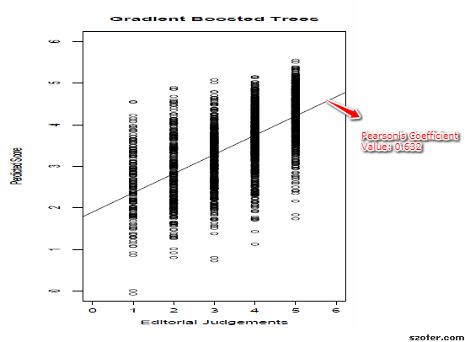
True vs Predicted Judgment

Slide 15
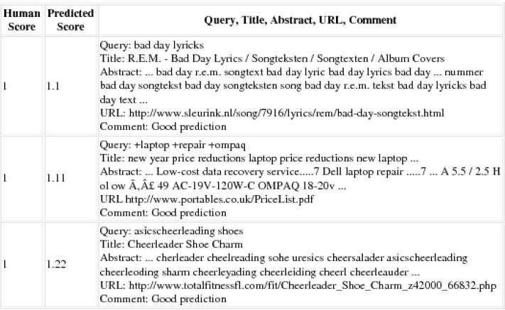
Low readability score by Human Judges and Algorithm

Slide 16
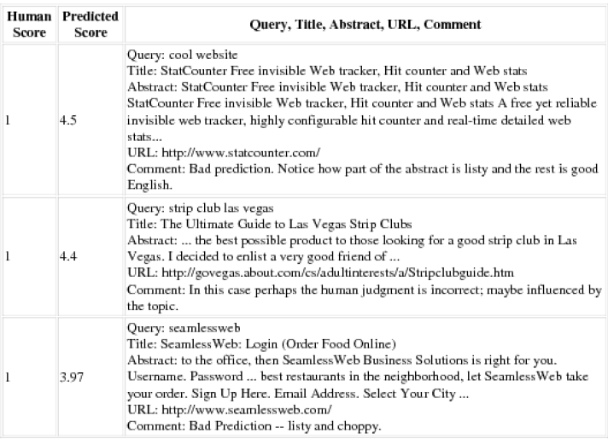
Low readability score by Human Judges and High readability score by Algorithm

Slide 17
Conclusion of the Paper
Instead of making features aggregate values over entire abstract perhaps feature should be on a per snippet basis.
Results are better than previous readability metrics
It can be used to estimate human quality judgments in real time
It can be used in automatic summarization algorithm to generate for readable summaries.

